Slide 1

Everything You Always Wanted to Know About Tax Controversy
2025 Delaware Trust Conference
Wilmington, Delaware
October 29, 2025
MICHELE F.L. WEISS
Principal & Tax Attorney
Holtz, Slavett & Drabkin, APLC
mweiss@hsdtaxlaw.com
(310) 550-6200
SHANNON L. POST
Director
Gordon, Fournaris & Mammarella, P.A.
spost@gfmlaw.com
(302) 652-2900

Slide 2
What do we mean by Tax Controversy?
Disputes between a taxpayer and a tax authority over a tax matter
This can cover a wide variety of matters– covers the start of an audit to litigation in court to collections

Slide 3
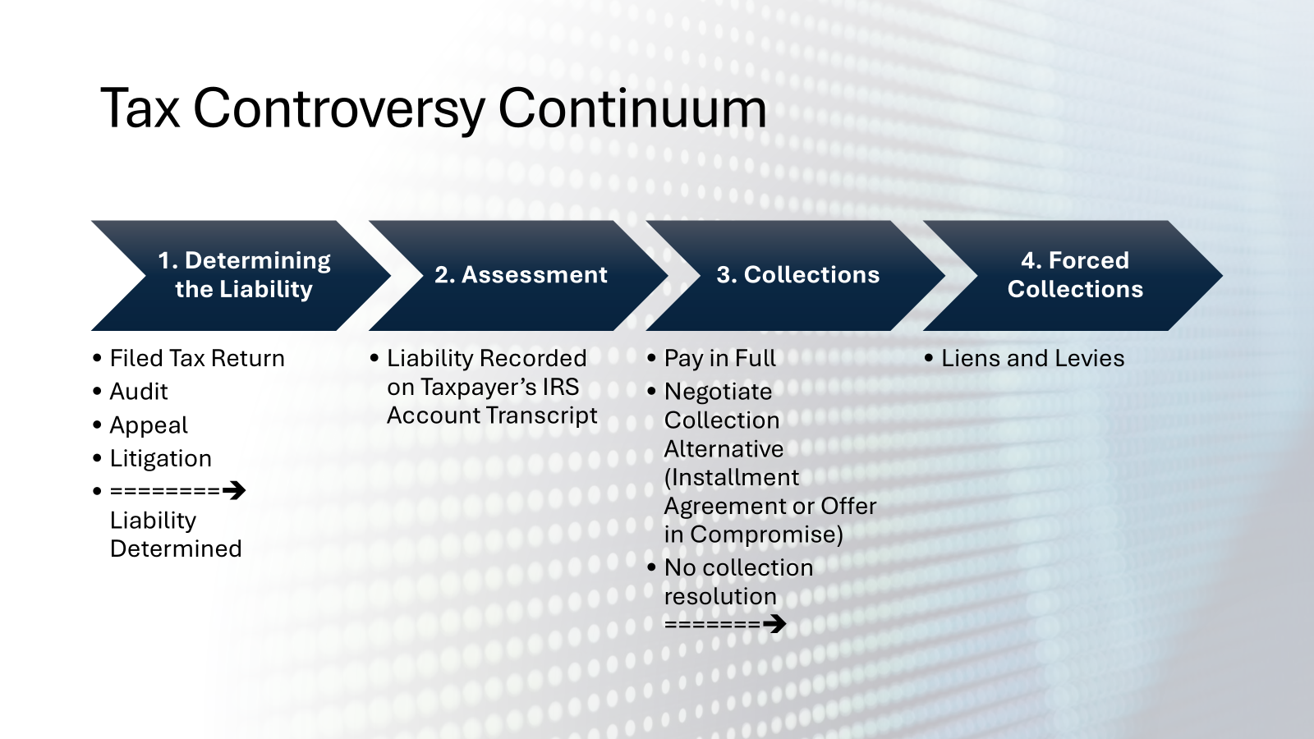
What is an IRS Audit
IRS review of a tax return to verify accuracy
Audits can be random
Audits can be triggered by certain red flags such as:
  Deductions that comprise a high percentage of the taxpayer’s adjusted gross income
  Large charitable contributions – especially non-cash charitable contributions
  Mismatching of reported income as compared to the amounts reflected on the taxpayer’s information returns (W-2s, K-1s, 1099’s, et al.)
  Taxpayer engaged in a transaction that the IRS has identified as abusive (“IRS Dirty Dozen”) –
    E.g. micro-captive insurance, donation of a large non-cash charitable contribution, abusive use of foreign pension plans,

Slide 4
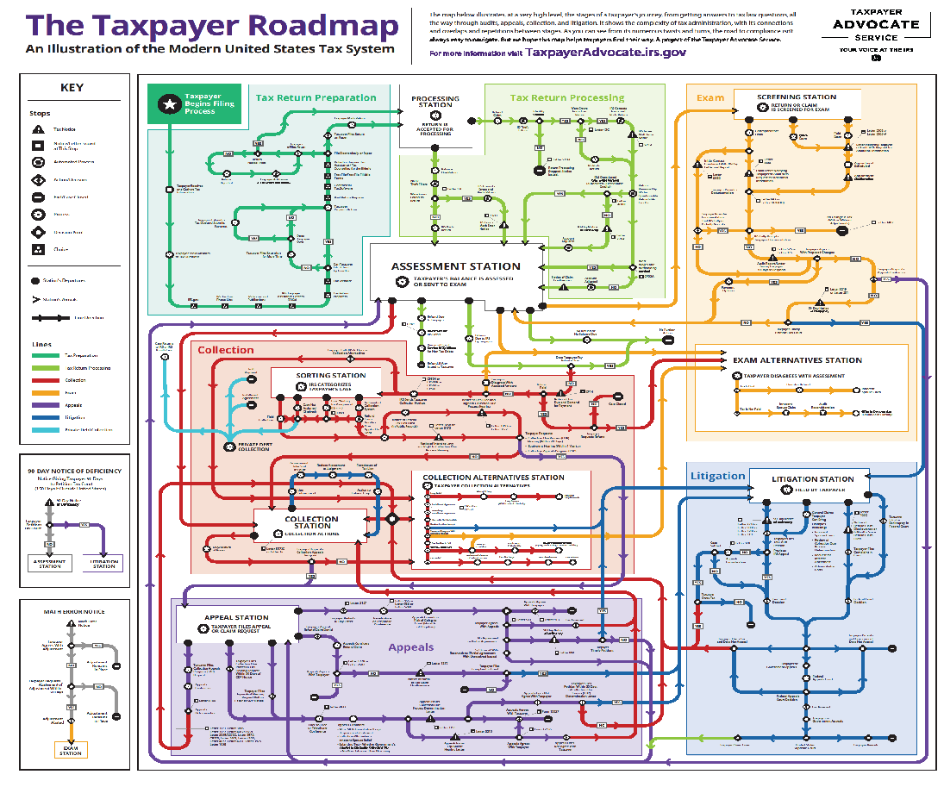

Slide 5
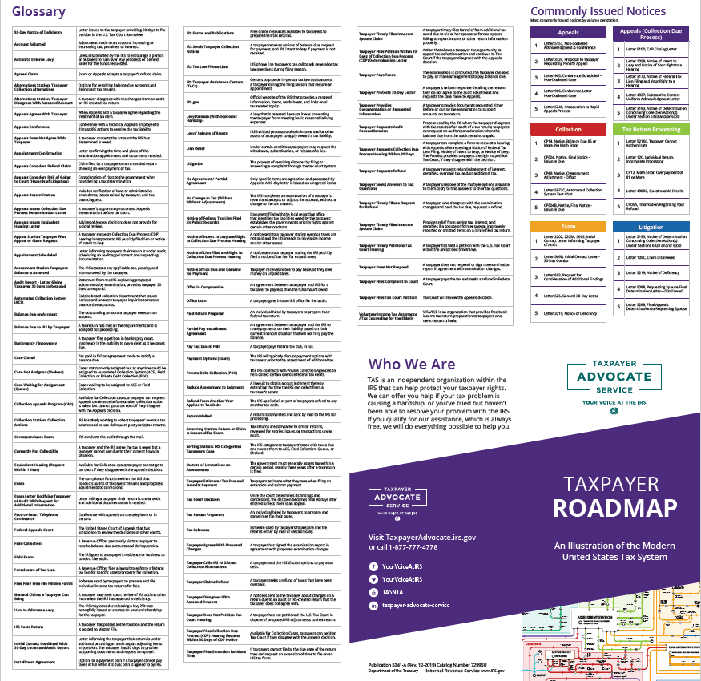
Don’t worry!
If you don’t know how to interpret the map, the IRS has a handy glossary to help…

Slide 6
State of the IRS
Workforce has shrunk by at least 25% -
  Combination of firings and voluntary departures
Audits were abandoned –
  Agent working on the audit left the IRS
  Many cases where the IRS resolved the audit with a “no change”
Longer timeline to get things done
Could result in fewer returns selected for audit
Can present difficulties to taxpayers trying to resolve their collection matters

Slide 7
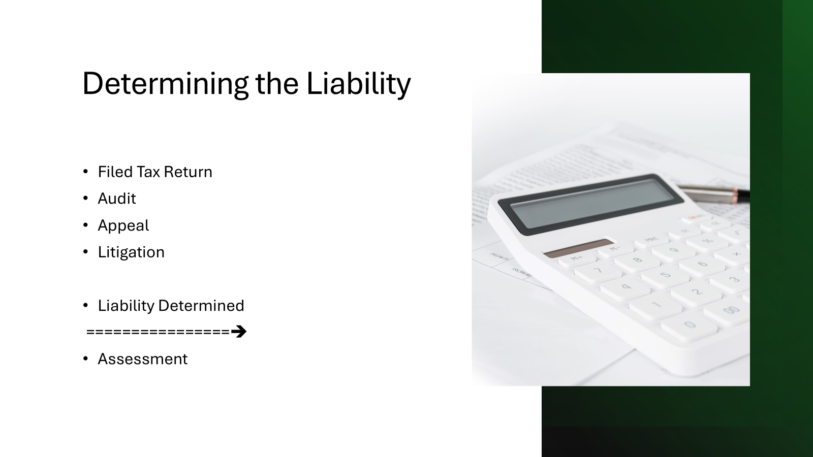

Slide 8
Types of IRS Audits
Correspondence Audit
Communication conducted by mail; IRS requests documents; live person not directly involved – generally no meetings or phone calls
Office Audit
Conducted at an IRS office; in-person meeting (or phone call or virtual)
Field Audit
At the taxpayer’s home, business, or representative’s office
Most comprehensive –
Usually involves multiple meetings and information and document requests and responses

Slide 9

Audit Selection/Risk
Randomly Selected
Taxpayer claimed deduction that was a high percentage of their total income
Taxpayer engaged in a transaction that the IRS is pursuing
E.g. Dirty Dozen

Slide 10
IRS Dirty Dozen list comparisons 2023-2025
2025 | 2024 | 2023
Email Phishing Scams | Bogus Tax Avoidance Strategies: | Bogus Tax Avoidance Strategies:
Bad Social Media Advice | Syndicated Conservation Easements | Micro-Captive Insurance Arrangements
IRS Individual Online Account Help from Scammers | Micro-Captive Insurance Arrangements | Syndicated Conservation Easements
Fake Charities | Schemes Involving International Elements: | Schemes with International Elements:
False Fuel Tax Credit Claims | Maltese Pension Plans | Offshore Accounts and Digital Assets
Improper Credits for Sick Leave and Family Leave | Transactions involving Digital Assets | Maltese Individual Retirement Arrangements Misusing Treaty
Bogus Self-Employment Tax Credit | High Income Filers Vulnerable to Tax Schemes face risk from: | Puerto Rican and Foreign Captive Insurance
Improper Household Employment Taxes | Improper Art Donation Deductions | Schemes Aimed at High Income Filers:
Overstated Withholding Scam | Charitable Remainder Trust Abuse | Charitable Remainder Annuity Trust
Misleading Offers in Compromise | Monetized Installment Sales | Monetized Installment Agreement
Ghost Tax Return Preparers | Spearphishing attacks | Spearfishing and Cybersecurity for Tax Professionals
New Client Scams and Spear Phishing | Tax Advice on Social Media | Social Media: Fraudulent Form Filing and Bad Advice
 | Ghost' Tax Preparers | Unscrupulous Tax Return Preparers
 | Fake Charities Exploiting | Fake Charities
 | OIC Mills
 | False Fuel Credit Claims | False Fuel Tax Credit Claims
 | Helpful scammers offering to set up an online account | Online Account Help from Third Party Scammers
 | Aggressive/Fraudulent ERC Claims and Promoters | ERC Claims
 | Phishing and smishing scams | Phishing and Smishing

Slide 11
The Beginning of an Audit
IRS sends an official letter in the mail
Never by phone or email – if you receive such a communication not by postal mail – it’s probably a phishing scam – do not respond – or at least engage a tax professional to determine if it is authentic
Letter will include:
Year(s) under audit
Often identifies specific issues that will be audited
Will usually request a telephonic response and possible set a scheduled meeting
May include some preliminary information and document requests

Slide 12
Preparing for the Audit
Gather relevant documents and information
Receipts and invoices for deductions
Appraisals for items requiring valuation
Bank statements
Review your return carefully.
Consult and/or retain a tax professional’s representation for the audit – tax attorney, CPA, and/or enrolled agent

Slide 13
The Audit Process
Stay calm and professional
If you are represented, cease all your interactions with the IRS – your representative will be your one voice with the IRS
Work with your representative to educate your representative about your business dealings and let them know if there are any questionable issues –
  Need to determine your risk of exposure in the audit
  Addressing problematic issues at the beginning can sometimes be the best route to a better result – but that needs to be analyzed and approached with caution
Make sure all documents and information submitted to the IRS is accurate and cannot be construed as being false or misleading
  Backdating documents is a fraudulent acts
Keep copies of all documents sent to the IRS during the audit
Send documents and info by a traceable method such as certified mail, fax, or the IRS’ upload tool (the letter from the IRS will provide instructions about how to access the tool)

Slide 14
The Audit Process – Part 2
Can be a grueling process
Can involve multiple information and document requests from the IRS
Gather information and documents to the extent possible
The Best Response is the Goldilocks response –
  Just enough to respond to the IRS’ request but not oversharing
May require obtaining old documents –
  The taxpayer has an obligation to substantiate the position taken on their return
Some issues can be resolved before the close of the audit
Work with your tax professional to help contain the scope of the audit

Slide 15
Possible Audit Outcomes
No Change – Return accepted as filed
Agreed Change – Taxpayer accepts an increased amount of tax or IRS accepts a refund
Disagreed Change -
  Taxpayer can dispute the IRS’ determinations
If there are unagreed issues, the IRS will issue a
“30-Day Letter”
  Letter gives taxpayer 30 days to respond that includes filing a protest and, if the taxpayer wants, to request a hearing with IRS Appeals
If no timely response to the 30-day letter → IRS issues:
  Statutory Notice of Deficiency – gives the Taxpayer 90 days to file a petition in Tax Court to dispute the IRS’ determinations
If no timely response to the Notice of Deficiency -> the IRS determination will be assessed on the taxpayer’s account and the taxpayer’s account will go to IRS Collections for payment/collection enforcement

Slide 16
Paths to IRS Appeals
Taxpayer ignores 30-Day Letter
Service issues Notice of Deficiency
Exam issues 30-Day letter
Taxpayer files Protest
Taxpayer files Tax Court Petition
After Pleadings Filed
APPEALS

Slide 17

Filing a Petition in U.S. Tax Court (versus other courts)
Main Prepayment forum for tax litigation
  Do NOT need to pay tax before going to Tax Court
Tax Court judges are tax attorneys
  They are experts in tax law.
  Many worked as IRS Counsel attorneys or in private practice as tax controversy attorneys before becoming judges.
Much more informal than other federal courts.
  Requirement for informal discovery (more on this later).
  Depositions are disfavored.
  Trial is much less formal, even though governed by Federal Rules of Evidence.
Tax Court judges based in Washington DC.
  Tax Court judges travel around the country for Tax Court calendars
  Larger cities have more calendars (for example, Los Angeles has the most with 1-2 every month except for July and August).
  Judges only in town for the calendars.
  Hearings can be held virtually.

Slide 18

Tax Court Case Outcomes
A Tax Court case can be settled with Appeals or Counsel.
Counsel will accept a settlement with Appeals as a resolution of the case.
Appeals and Counsel will focus on the individual adjustments and usually settle the case adjustment by adjustment.
  Exception: Counsel attorneys have the authority to enter into flat-dollar settlements for smaller cases (usually under $50,000 at issue).
After parties reach a basis for settlement on the adjustments, IRS will request computations from another department inside the IRS.
Parties then file a stipulated decision document with the Court.
  In deficiency case, decision states the additional amount of tax and penalties (if any) determined through the settlement.
  In CDP case, decision states whether settlement officer abused or did not abuse their discretion.

Slide 19

Other Fora:
District Court and Court of Claims
For U.S. district court or Federal Court of Claims:
  Need to pay the tax and sue for a refund
  Judges don’t necessarily have expertise in tax (in fact, sometimes judges would much rather avoid tax cases).
  IRS represented by Department of Justice (not IRS Counsel attorneys).
  District court litigation can be much more expensive than Tax Court litigation (maybe twice as much).
    Much more likely to have extensive discovery and depositions in district court.
    Much more likely for government to attempt to resolve through a motion for summary judgment in district court.

Slide 20

IRS Independent Office of Appeals during a Tax Court Case
After IRS files its answer in a deficiency case, the following will happen:
  If Notice of Deficiency was issued by IRS Examinations (not Appeals):
    Case forwarded to IRS Appeals to pursue settlement
    IRS Appeals analyzes hazards of litigation
    If petitioner presents new information to Appeals that petitioner did not previously present to IRS Examinations:
      Appeals sends information back to IRS Examination for review and consideration
      IRS Examinations has 75 days to provide its views on the new records and to inform IRS Appeals whether new information changed IRS Examination’s position.
      If Appeals and petitioner do not resolve the case, then IRS Appeals will send it back to IRS Counsel for trial preparation.
      If Appeals issued the Notice of Deficiency, then Tax Court case remains with IRS Counsel for trial preparation. Taxpayer/petitioner does not get two opportunities with Appeals.
In CDP Tax Court case, Appeals issues Notice of Determination =
  Need to petition Appeals’ notice
  Go back to Appeals only if case is remanded

Slide 21

Right to Appeal a Tax Court Decision
Four steps to end of Tax Court case after trial and briefing:
  First, Tax Court issues an opinion (this could take years).
  Second, if the Court does not rule entirely in favor of one party, then the parties must agree on Rule 155 computations for the additional amount of tax based on the opinion.
  Third, parties file the Rule 155 computations.
  Fourth, Court enters a decision.
Either party can appeal a Tax Court decision.
  Appeals from the decision.
  Do not appeal from the Tax Court’s opinion after trial and briefing. Must wait for decision.
Appeal lies with Circuit Court of Appeal that would have jurisdiction over petitioner at the time that petitioner filed the petition
Address listed on the petition is important for determining which Circuit’s law applies to the case. See Golsen v. Commissioner, 54 T.C. 742 (1970).

Slide 22



Slide 23
Now what do you do? What are your client’s options?

Slide 24
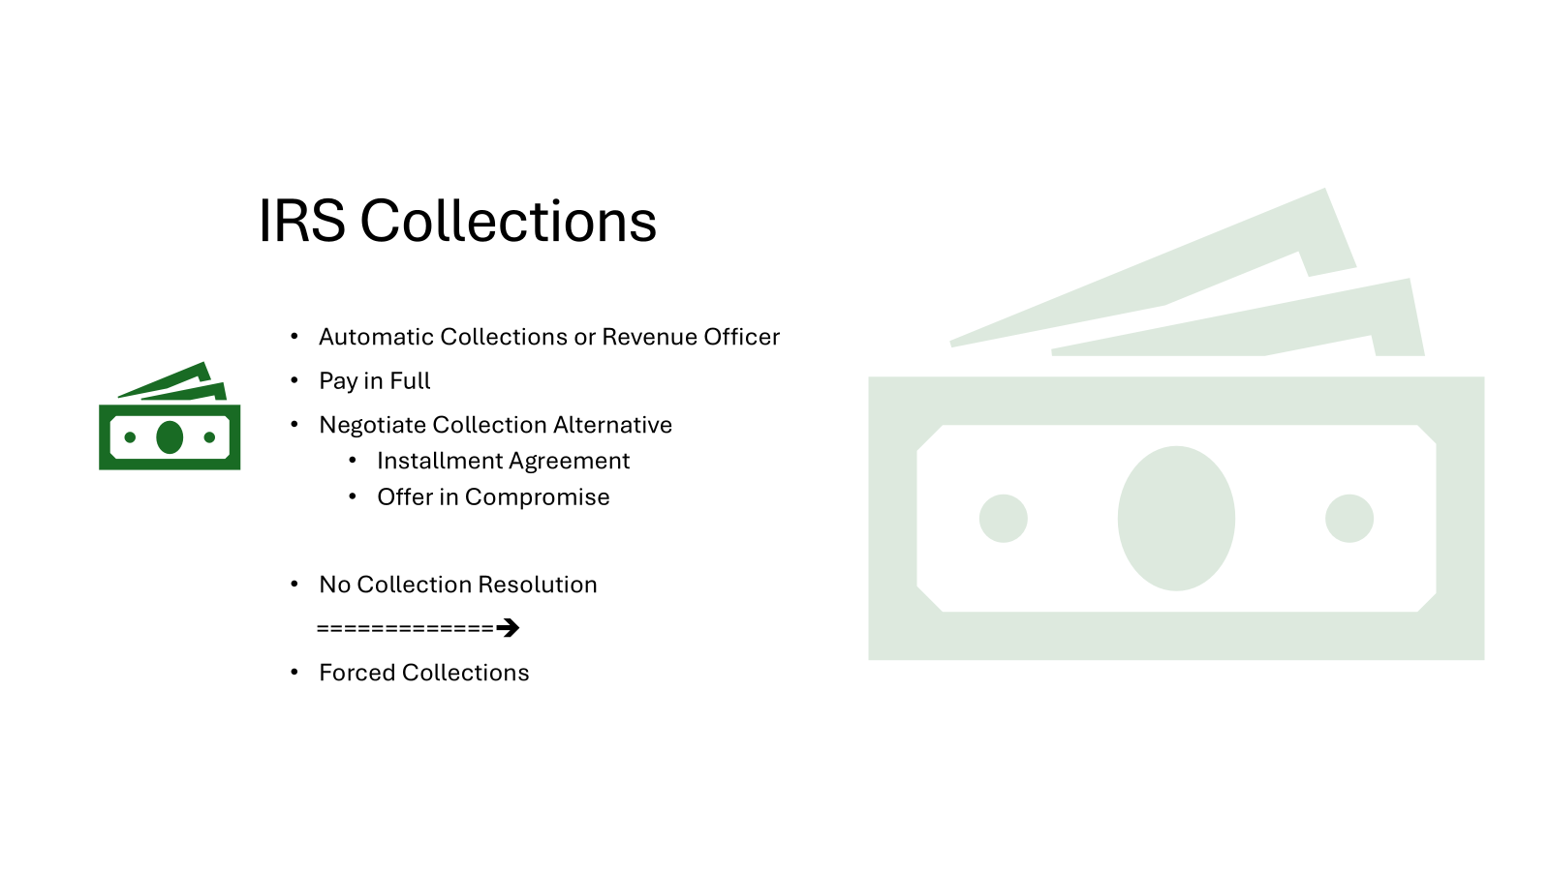

Slide 25

Introduction to IRS Collections
Assessment – the moment that a taxpayer’s tax liability is recorded on the taxpayer’s account –
Collection Statute Expiration Date (“CSED”)
  IRS = 10 years from the date of assessment –
  Collection statute tolled for certain actions such as the time period during which a taxpayer negotiates a collections alternative or while the taxpayer’s bankruptcy action is pending
Collection Alternative based on Ability to Pay
  Calculation of net monthly income =
    gross income
    less allowable expenses
  Calculation of net equity in assets
Personal Liability > $50,000:
taxpayer be certified to the State Department for US passport revocation
passport revocation reversed when taxpayer becomes collection compliant =
either full paid or enters into a collection alternative accepted by the IRS

Slide 26

If the taxpayer is assessed a balance due…
They can always pay it (of course)
If the taxpayer does not pay the balance due,
  IRS issues Notice of Tax Due and Demand for Repayment
  Options??
    Taxpayer can pay it and request a refund
    Taxpayer can disagree with assessment
      Request audit reconsideration
      Offer in Compromise (Doubt as to Liability)
      Innocent Spouse Claim
    If the Taxpayer does nothing, the IRS will start to send a set of escalating collection notices:
    CP 501 First Reminder
    CP 503 First Warning of Collection Action
    CP 504 and CP504B Final notice before IRS can legally seize property via levy

Slide 27
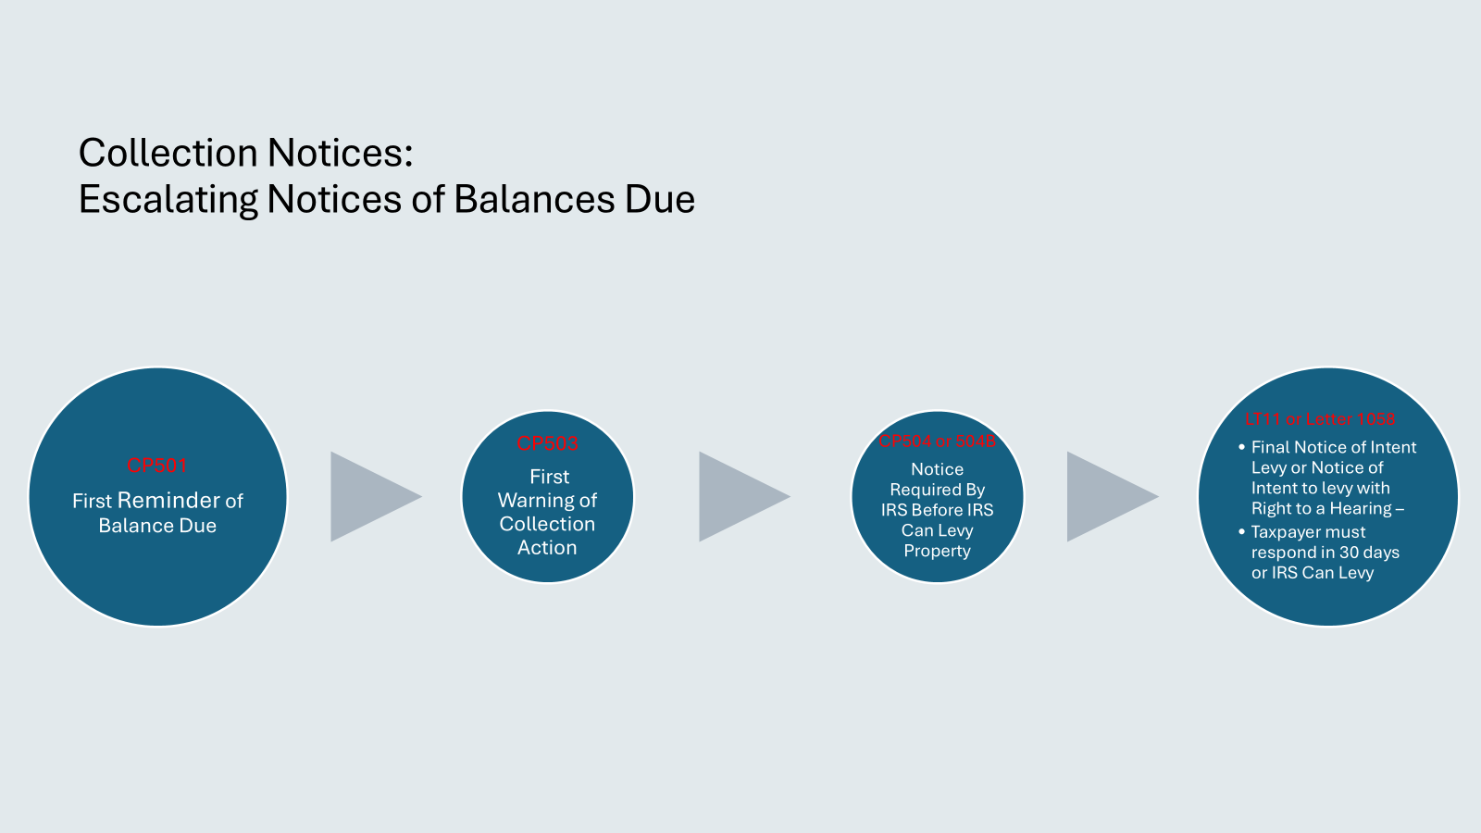

Slide 28
Collection notices give you an opportunity to pursue collection alternatives with the IRS
Collection Alternatives:
If the Taxpayer doesn’t respond:
Wrongful Levy/ Release
Installment Plans
Offers in Compromise
Offer in Compromise (Doubt as to Liability)
Innocent Spouse
Currently Not Collectible Status
Lien Relief
IRS internally categorizes the case for forced collections:
  Send for Field Collection
  Shelve It (Not Assigned)
  Queue It
  Automated Collection

Slide 29

Offer in Compromise (“OIC”)
Negotiated amount that is less than the liability
Pennies on the dollar? Depends on the taxpayer’s financial profile
Calculation is based on:
  Net equity in assets +
    12 times net monthly income
      If taxpayer will pay full OIC within 5 months from the date OIC is accepted
      Must include 20% of offer with OIC submission
    24 times net monthly income
      If taxpayer will pay full OIC within 2 years from the date OIC is accepted
      Must include monthly payment with OIC submission and continue to make monthly payments while the OIC is pending
The higher the amount due and the shorter the CSED, the more likely that OIC will be accepted
Taxpayer must remain tax compliant for 5 years after OIC is accepted. If not, OIC will default and taxpayer back to being non-compliant
Refunds will be taken by taxing authority from the time the OIC is submitted and until full paid; however, the refund will not be credited to the taxpayer for the OIC

Slide 30


Installment Agreement
Full Pay = full tax liability will be paid on or before the CSED if taxpayer makes all the agreed payments
  Taxing authorities tend to like it knowing they will ultimately be full paid
Partial Pay = full tax liability will not be paid on before the CSED even if taxpayer makes all the agreed payments
  Similar to an OIC
Taxpayer considered tax compliant from the time submits offer and throughout the tenure of the agreement = no levies taken
BUT taxing authority will likely file a lien

Slide 31

Bankruptcy
Taxes can be discharged if they are old and cold =
  Tax return must have been due at least 3 years before
  Debtor must have filed a valid return at least 2 years before
  Tax assessment must have occurred at least 240 days before bankruptcy filing
  Muddier if a lien has been filed for the liability
Can discharge consumer debt, as well
If only have tax debt, not always the recommended option
Bankruptcy case filings are public
Can affect debtor’s credit

Slide 32
What is a notice of lien or intent to levy?
Notice of Federal Tax Lien (NFTL)
Notice of Intent to Levy
NFTL is a filed public record
Once filed in the appropriate office, the lien is secured
A notice of filed lien is then sent to Taxpayer
Just that an intention
The levy is not actually completed until appeal rights lapse or appeals decides against the Taxpayer

Slide 33
Why did your client receive a notice of lien or intent to levy? How did they get here?
They ignored several prior notices
They couldn’t agree on a proposed assessment
They couldn’t agree on a collection alternative

Slide 34
Taxpayer Collection Rights
Collection Due Process Hearing (CDP)- Request within 30 days
Collection Equivalent Hearing
Collection Appeals Program (CAP)

Slide 35
Taxpayer will be granted an Appeals Conference
Appeals Officers can consider a broad range of remedies:
  Whether all procedures were correctly followed
  Collection Alternatives
  Whether the collection action is no more intrusive than necessary
Appeals will issue a determination letter:
  If it is a CDP hearing, and Appeals does not agree with Taxpayer, the Taxpayer can file a Petition with the Tax Court within 30 days of the determination letter
  If it is an equivalent hearing, and Appeals does not agree with Taxpayer, the Taxpayer can still have collection alternatives considered
  If it is a CAPs hearing, and Appeals does not agree with Taxpayer, the Taxpayer can still have collection alternatives considered

Slide 36
Freezing Collections
Collection Freeze =
  IRS will not take new collection actions from the time they are submitted and until they are resolved
Taxpayer actions that will Freeze Collections:
  Submit an OIC
  Propose an installment agreement
  Request innocent spouse relief
  File for bankruptcy
Taxpayers should weigh concerns about any publicity surrounding their pursuit of a collection alternative

Slide 37
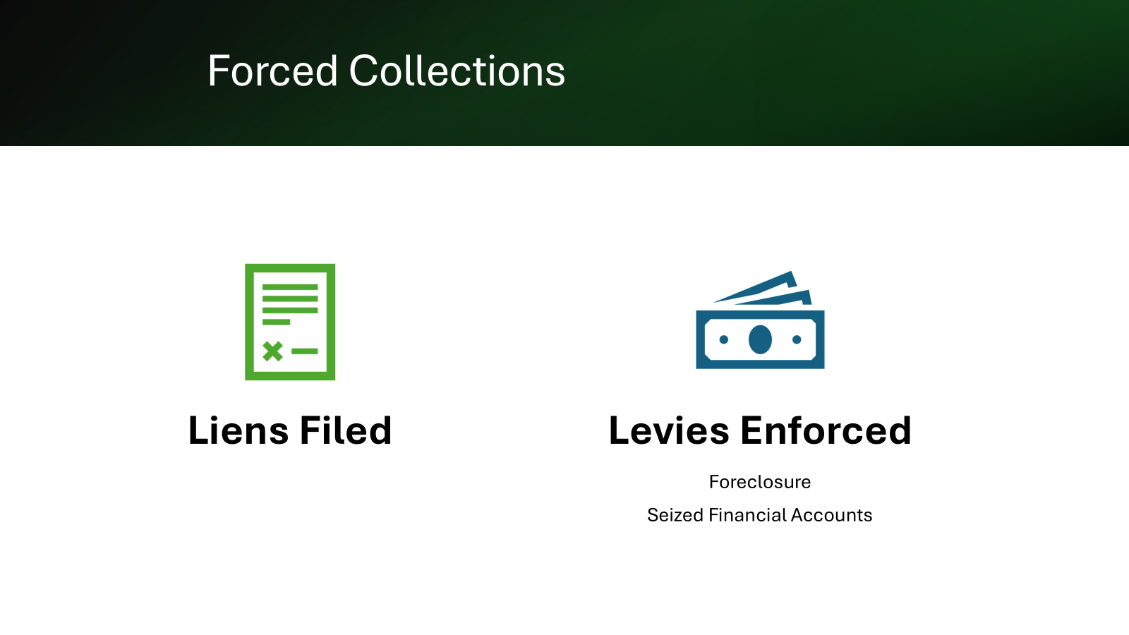

Slide 38
Questions?????
Michele F.L. Weiss, Principal
Shannon L. Post, Director
Holtz, Slavett & Drabkin, APLC
10940 Wilshire Blvd, Suite 2000
Los Angeles, CA 90024
310-550-6200
mweiss@hsdtaxlaw.com
Gordon, Fournaris & Mammarella, P.A.
1925 Lovering Avenue
Wilmington, DE 19806
302-652-2900
spost@gfmlaw.com

